Slide 1

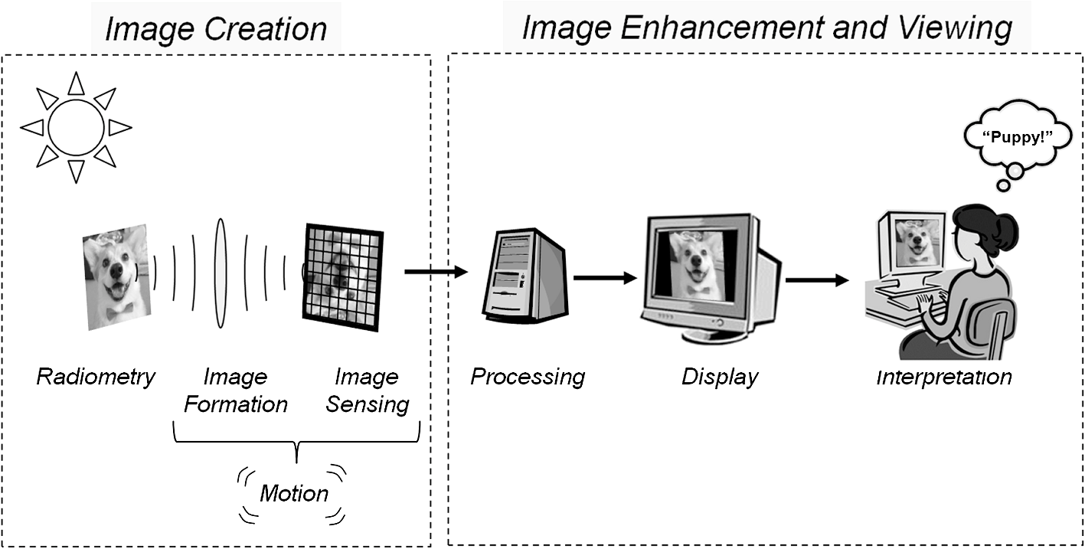
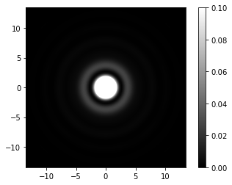
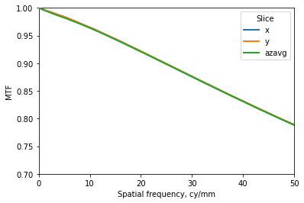
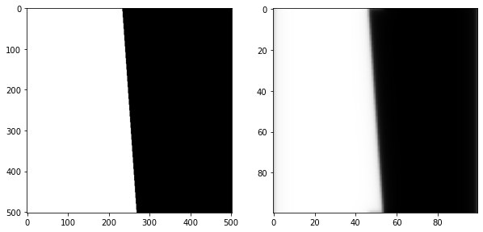
Image Synthesis Via The Imaging Chain
¹Sean Staub
¹Department of Physics
Background
Methods
When designing an imaging device such as a digital camera, optical engineers often develop a forward model of the device by modeling the imaging chain. This process aims to model the effect that every component has on the imaging capability of the device. With a forward model in hand, synthetic imagery can be produced, giving optical engineers a chance to simulate a given design and assess its performance prior to building anything.
A forward model of a Sigma 50mm lens at F/4 with a circular aperture and a full frame 42MP CMOS sensor array with pixel pitch of 4.5um is constructed in Prysm. Restricting the model to monochromatic light of 550nm, relatively small (100-400 pixels), on-axis images and small apertures, allows LSI system theory to be applied when generating synthetic images.
To account for sensor sampling/integration and to avoid aliasing of phase data, an intermediate higher resolution is determined by considering the Q factor of the model and the Nyquist sampling theorem.
For on-axis images at F/4, it is reasonable to model the aberration of the wavefront as spherical, Zernike polynomials are employed to do so.
The following specifications are used:
Final Output Resolution: 100x100 pixels
Wavelength of Light: 550nm (center of visible region)
Focal Length of Lens: 50mm
F/# of Lens: 4 (focal length/aperture diameter)
Pixel Pitch: 4.5um (inter pixel spacing, center-center)
Phase Mode: Zernike n=4, m=0 (spherical aberration)
Phase Optical Path Difference: 1/16 of a wavelength
Oversampling Factor: 5
The following steps are taken in Prysm:
Construct the pupil function
Obtain PSF via propagation from pupil to image plane
Obtain MTF via Fourier transform
Alter phase OPD so that MTF matches known values
Convolve test pattern with PSF and resample
Results
Figure 2 shows the resulting PSF of the lens. The PSF is interpreted as the image of a point object formed by lens, showing the affects of diffraction and aberration on the imaging capability of the lens.
Under LSI system theory, the PSF is the impulse response of the lens. Convolving, or “smearing”, the PSF over the test pattern gives the final image.
Figure 3 shows the MTF of the lens, representing the spatial frequency response in terms of contrast. The MTF is the magnitude of the Fourier transform of the PSF.
Figure 1. The fundamental links of the imaging chain [1].
To construct a simple forward model of a digital camera, the effect of the lens and the sensor array on incoming wavefronts of light must be modeled. The lens will diffract and aberrate the wavefront, and the sensor array will sample and integrate the wavefront. Imposing certain restrictions allows the model to be treated as a linear shift-invariant system (LSI). By employing Fraunhofer diffraction theory, the point spread function (PSF), which acts as the systems impulse response, can be derived and synthetic imagery can be produce via convolution. To create an accurate model, the “shape” of the wavefront at the lens can be structured such that the modulation transfer function (MTF) of the lens closely matches that of a known lens.
The general theory required for this project is derived from Robert D. Fiete’s book Modeling the Imaging Chain of Digital Cameras. The model is constructed in the physical optics modeling package Prysm.
The goal of this project is to develop knowledge and skills often employed by optical engineers when designing an imaging device.
um
Figure 2. Lens point spread function (PSF)
Figure 3. Lens modulation transfer function (MTF)
Figure 4 shows the slanted edge test pattern before and after convolution with the PSF and resampling to the final output resolution.
The final image is appropriately blurred, representing an accurate image formed by the specified model.
References and Acknowledgements
[1] R. D. Fiete, Modeling the Imaging Chain of Digital Cameras, SPIE Press, Bellingham, Washington (2010).
Prysm: https://github.com/brandondube/prysm
Special thanks to Brandon Dube, Prysm’s author, for providing tons of support.
Figure 4. Slanted edge prior to, and post convolution/resampling

